Slide 1
A Research Project (IFN702)
Educational Data Mining:
Analyze and Predict student’s academic performance

Slide 2
Acknowledgements
Roles | Name
Author | Zhiying Zhou (9835580)
Academic Supervisor | Dr. Guido Zuccon
Coordinator | Dr. Charles Wang

Slide 3
Contents
1.Introduction
1.1 Background
1.2 motivation
1.3 Objective
1.4 Deliverables
2.Project Approach
3.Contributions
3.1 Implementation steps
3.2 Project findings
3.3 Implications of the findings

Slide 4
1.Introduction
1.1 Background
This project aims to analyze and predict students’ academic performance. The mining of students’ interaction & performance in educational settings is an emerging field of application of data mining.

Slide 5
1.Introduction
1.1 Background
This project aims to analyze and predict students’ academic performance. The mining of students’ interaction & performance in educational settings is an emerging field of application of data mining.
The mining of such data allows early identification of :
students struggling with specific subjects/educational styles (interactions)
students who are more likely to fail the subject/examination

Slide 6
1.2 Motivation
Examination plays a vital role in any student's life. The marks obtained by students in the examination affect their study and career life, especially in this competitive modern society.

Slide 7
1.2 Motivation
Examination plays a vital role in any student's life. The marks obtained by students in the examination affect their study and career life, especially in this competitive modern society.
Predicting whether students will pass or fail an examination prior to the examination itself allows to devote extra efforts to improve their studies and help them to pass the examination.

Slide 8
1.2 Motivation
Examination plays a vital role in any student's life. The marks obtained by students in the examination affect their study and career life, especially in this competitive modern society.
Predicting whether students will pass or fail an examination prior to the examination itself allows to devote extra efforts to improve their studies and help them to pass the examination.
This will not only benefit the students, but also the schools and parents.

Slide 9
1.3 Objectives
We predict students’ academic performance based on interactions and data recorded in an educational dataset.

Slide 10
1.3 Objectives
We predict students’ academic performance based on interactions and data recorded in an educational dataset.
Identify which features in this dataset affect the students’ academic performance most.

Slide 11
1.3 Objectives
We predict students’ academic performance based on interactions and data recorded in an educational dataset.
Identify which features in this dataset affect the students’ academic performance most.
The methods developed in this project could be extended to analyze all kinds of educational performance to suit all kinds of students in different grade levels, gender, nationality, and it may even be suitable for university student.

Slide 12
1.4 Deliverables
There are 2 main types of deliverables in this study:
1. A final report
2. One single zip archive folder which contains the following: Rmarkdown file, Rmarkdown PDF and HTML, and the student’s academic performance dataset.

Slide 13
2. Project Approach
Data set:
The dataset consists of 480 student records and 16 features. The features are classified into three major categories:
(1) Demographic features such as gender, grade levels, topic and nationality.
(2) Academic background features such as educational stage, grade Level and section.
(3) Behavioral features such as raised hand on class, opening resources, answering survey by parents, and school satisfaction.
The students are classified into three numerical intervals based on their total grade/mark: Low-Level, Middle-Level, High-Level

Slide 14
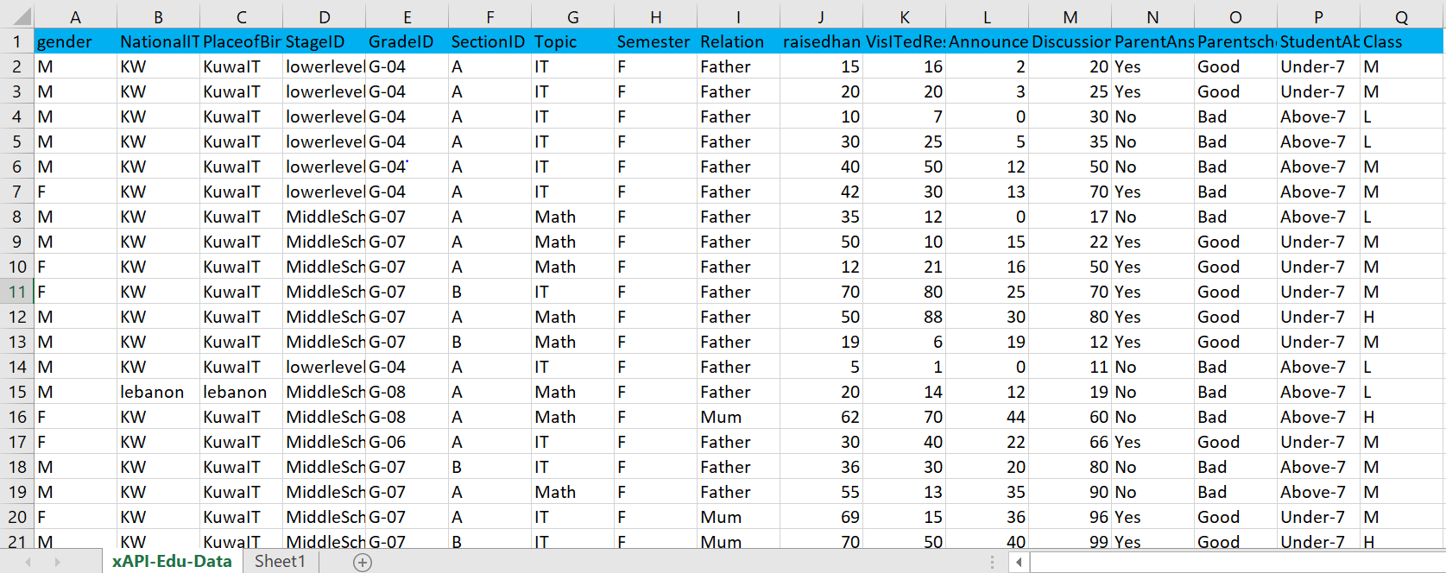
Edu data set: 480 records in total

Slide 15
Main steps taken in this project:
1. Pre-process of the datasets. Clean the dataset, remove the not meaningful columns or rows; and
2. Explore the datasets. Explore the distribution of the datasets on different features: gender, nationality, grade, topic, parental satisfaction etc. (like girls raises more hand, more discussions in high school etc.); and
3. Find underlying relationships: e.g., parents who are not satisfied and do not answer surveys, connection with study activity and performance (raising hand, discussion, absence, parental satisfaction, answering survey etc.); and
4. Build prediction model, e.g. decision tree or regression model, to predict the student’s academic performance.
5. Evaluate the predictions of the models by comparing their accuracy.

Slide 16
Project Management Approach
Project approach
Waterfall software development methodologies are good for small projects that contain clear requirements
1. Planning and Requirements.
2. Design and modeling the project.
3. Follow the plan to develop the R program to analyse and predic the datasets. 4. Test and evaluate the results to ensure the quality of the project.
5. Analyse, evaluate and improvement.
Also make gan chart Project Gantt Chart to manage the project an control risk

Slide 17
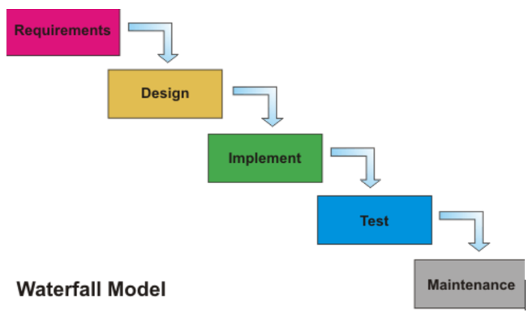

Slide 18
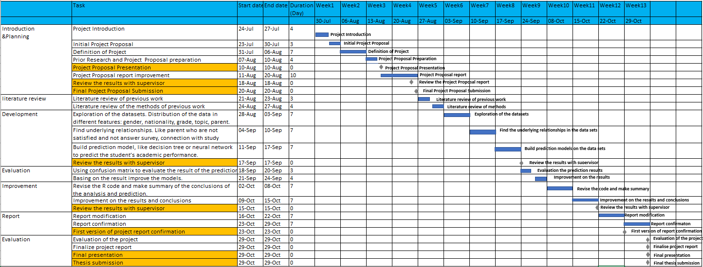
Project Gantt Chart

Slide 19
3.Contributions
3.1 Implementation steps:
Task 1. Exploration of the students' academic performance datasets
Task 1.1. Preprocess the data set: Reorder the "Class"" column, "H","L","M“ => "H","M","L" …
Task 1.2. Bar plots of classifical values distribution:
Task 1.3. Histogram of numerical values distribution:
Task 2. Exploration of the relationships between different features of the students' academic performance datasets
Task 3. Build prediction models to predict the students' academic performance, and evaluate the performance
Preprocess: remove some unimportant features.
Prediction model 1 -- Decision tree
Prediction model 2 – Random Forest
Prediction model 3 -- Support Vector Machines
Task 4. Improvement of these prediction models using N-folder cross validation for the prediction models above
Using N-folder cross validation on prediction model 1 -- Decision tree
Using N-folder cross validation on prediction model 2 -- Random Forest
Using N-folder cross validation on prediction model 3 -- Support Vector Machines

Slide 20
3.2 Findings
Main findings from Task 1:
1. There are more girls in the high achievers class (high class) than in the low class; boys are the opposite. Girls' parents have higher school satisfaction than boys. Boys are more frequently absent for more than 7 days.
2. There are very small differences in class performance with respect to place of birth and nationality. The findings between place of birth and nationality are very similar. This justify using only nationality in place of both for the next steps.

Slide 21
3.2 Findings
Main findings from Task 1:
1. There are more girls in the high achievers class (high class) than in the low class; boys are the opposite. Girls' parents have higher school satisfaction than boys. Boys are more frequently absent for more than 7 days.
2. There are very small differences in class performance with respect to place of birth and nationality. The findings between place of birth and nationality are very similar. This justify using only nationality in place of both for the next steps.
3. Middle school has the most students. Lower-level has higher rate of above 7 days of student absence. Lower-level has the highest rate of low class students (low achievers). Highschool has the highest rate of high class students (high achievers). Middle school has the highest rate of medium class students.
4. Biology has the highest ratio of high class students, but also the highest ratio of low class students. Geology has the highest ratio of medium class students.

Slide 22
3.2 Findings
Main findings from Task 1:
1. There are more girls in the high achievers class (high class) than in the low class; boys are the opposite. Girls' parents have higher school satisfaction than boys. Boys are more frequently absent for more than 7 days.
2. There are very small differences in class performance with respect to place of birth and nationality. The findings between place of birth and nationality are very similar. This justify using only nationality in place of both for the next steps.
3. Middle school has the most students. Lower-level has higher rate of above 7 days of student absence. Lower-level has the highest rate of low class students (low achievers). Highschool has the highest rate of high class students (high achievers). Middle school has the highest rate of medium class students.
4. Biology has the highest ratio of high class students, but also the highest ratio of low class students. Geology has the highest ratio of medium class students.
5. The students who have moms as guardians have higher chances to get high class marks. Students whose parents answer the survey are the ones getting good marks. Student that have more absences are those getting low marks.
6. High achiever students are more likely to raise hands, visit resources, view announcements and participate in discussions. Low achiever students raised hands, visited resource, viewed announcements and participated in discussions few times.

Slide 23
Main findings from Task 2:
1. The analysis further confirmed our findings in the previous step: High achiever students raised hands, visited resource, viewed announcements and discussed more times.
2. Girls have more hand raised and visit more resources.
3. There are more raised hands, visited resources and announcements view in middle schools. More discussions in high schools.
4. Interestingly, IT subjects have very few hand raises although most students study there.
5. Students with guardians mothers have more hand raises, visited resources and announcements view.
6. Students whose parents answered survey and had good satisfaction, have more hand raised, visited resources, announcements view and discussion.
7. Students with more absences have the least raised hands, visited resources, announcements and discussion.

Slide 24
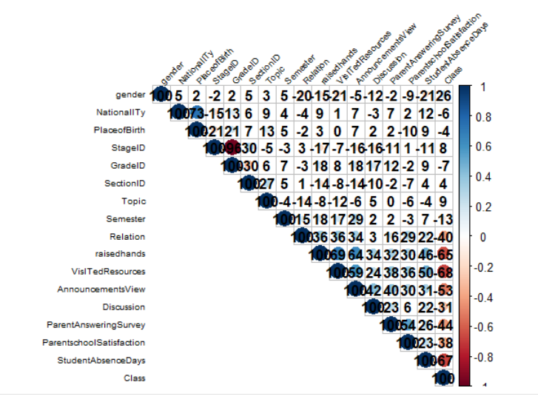
Task 3 : Prediction models
Features correlation plot

Slide 25
Features correlation plot
Important features:
Raisehands
VisitedResources
AnnouncementView
StudentAbsenceDays

Slide 26
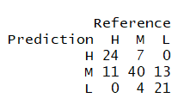
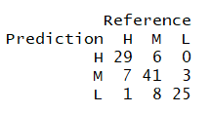
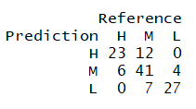
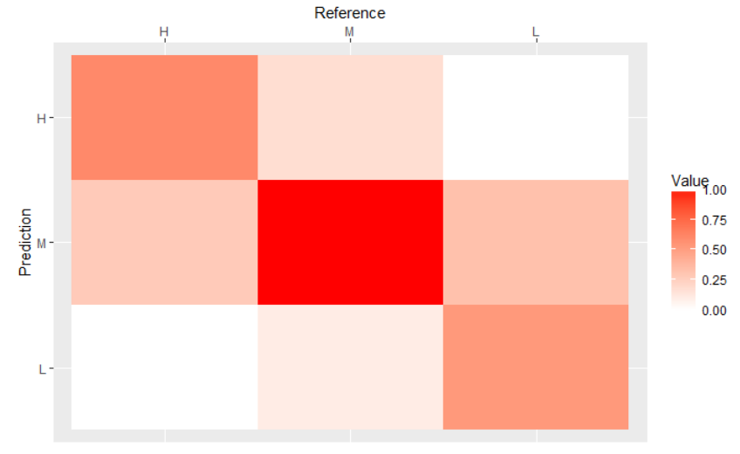
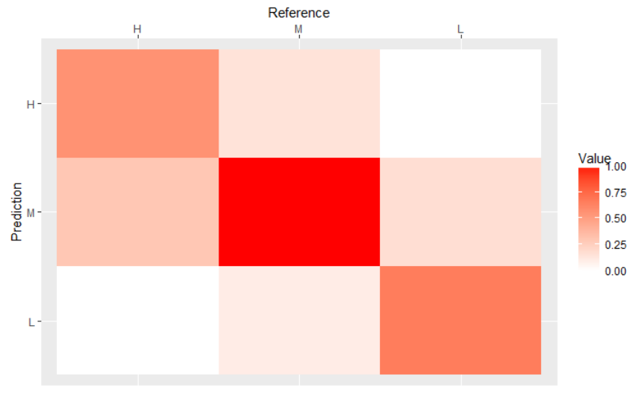
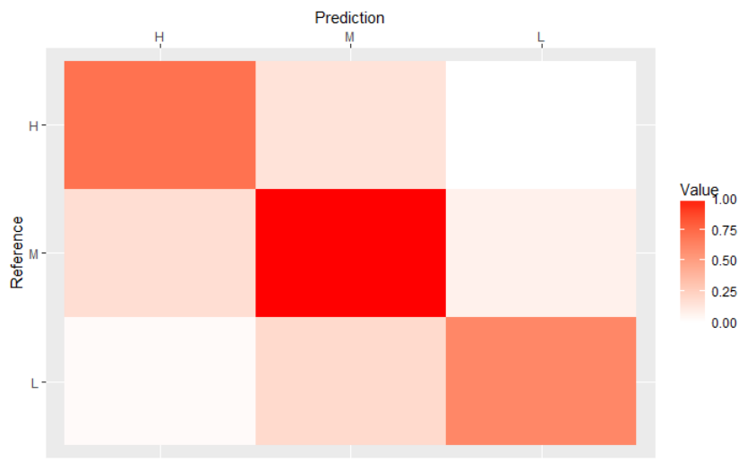
Decision tree Random forest SVM
Performance of 3 basic models and heat maps

Slide 27
Decision tree Random forest SVM
Comparison of 3 basic models and heat maps

Slide 28
Summary of the performance of models
Data set | Models | Accuracy | Mean Precision
Basic dataset | Decision Tree | 0.7083 | 0.8411
 | Random Forest | 0.7583 | 0.8742
 | VSM | 0.7917 | 0.8920

Slide 29
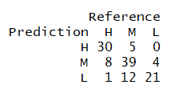
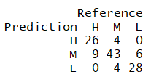
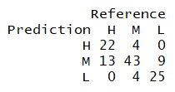
Decision tree Random forest SVM
Comparison of 3 models training on 10-folders cross validation

Slide 30
Decision tree Random forest SVM
Comparison of 3 models training on 10-folders cross validation

Slide 31
Summary of the performance of models
Data set | Models | Accuracy | Mean Precision
N-folder Cross Validation Data set | Decision Tree | 0.75 | 0.8713
 | Random Forest | 0.8083 | 0.8963
 | VSM | 0.75 | 0.8625

Slide 32
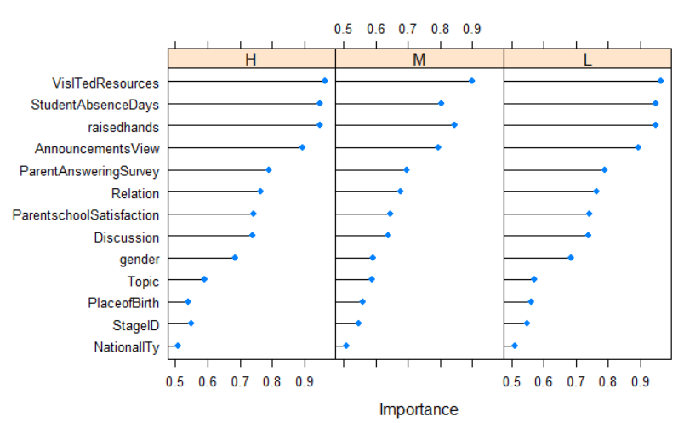
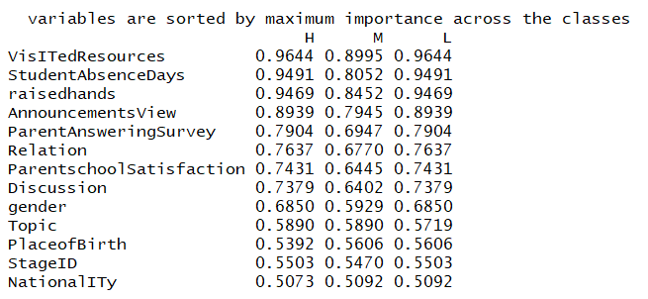
Variable importance plot
1. Decision tree model

Slide 33
Variable importance plot
1. Decision tree model

Slide 34
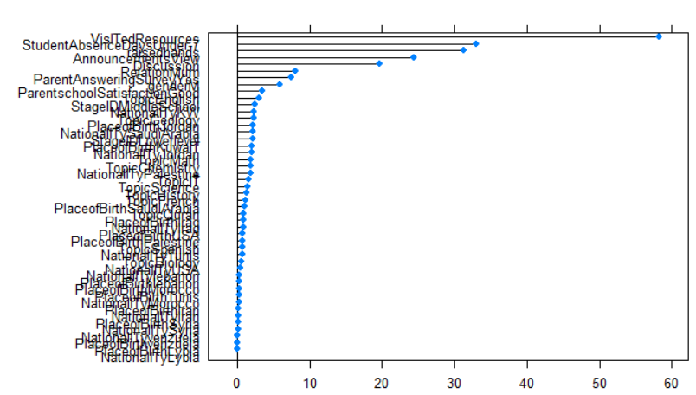
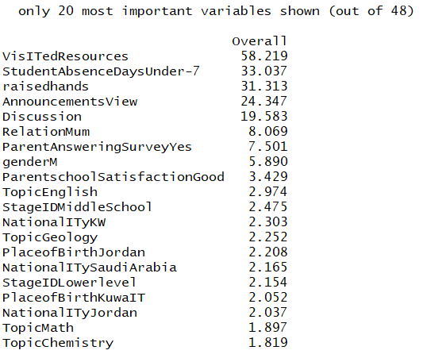
2. Random Forest model

Slide 35
2. Random Forest model

Slide 36
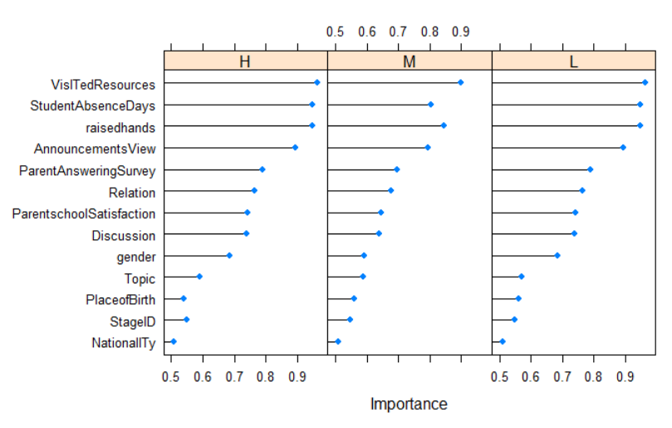
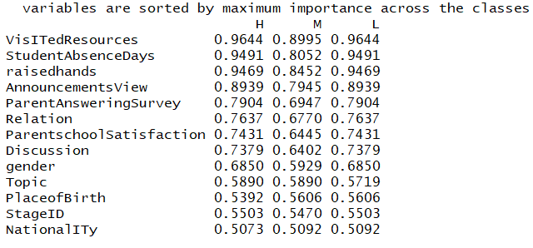
3. SVM model

Slide 37
3. SVM model

Slide 38
Final Conclusions:
1. Random forests model outperformed all the models by training N-fold cross validation data set. It got the highest rate of accuracy and precision. As a result, the random forest prediction model is recommended for this educational data mining project.

Slide 39
Final Conclusions:
1. Random forests model outperformed all the models by training N-fold cross validation data set. It got the highest rate of accuracy and precision. As a result, the random forest prediction model is recommended for this educational data mining project.
2. The most important activities that related to students' academic performance are VisITedResources, raisedhands, StudentAbsenceDays, AnnouncementsView and Discussion. Then the Relation, ParentAnsweringSurvey, gender and ParentschoolSatisfaction also has some connection with the academic performance. Students' academic performance has little connection with topic, StageID, Nationality, PlaceofBirth, Grade ID, Section ID and semester based on this educational data set.

Slide 40
3.3 Implications
The analysis of Educational Data seeks to use data to better understand students and their study, and to develop computational approaches that combine data and theory to transform educational practices to benefit students.
This study can facilitate the students and the lecturers to assist students to perform well.
This study helps identify students who require special attention, minimize the failure rate and take actions for future semester examination.
Future work will validate the models on more educational data, in particular from different institutions/backgrounds

